Slide 1
Water Quality Prediction using Machine Learning
DSCET
TEAM MEMBERS:
REGISTER NUMBER | NAME
310519106042 | NIKHIL KUMAR JHA
310519106049 | PINTU KUMAR
310519106093 | RAJESH KUMAR
UNDER THE GUIDANCE OF
Mrs.N.BHUVANESWARI
Assistant Professor
Department of ECE
DEPARTMENT OF ELECTRONICS AND COMMUNICATION ENGINEERING
ACADEMIC YEAR 2022-2023(EVEN SEMESTER)
DHANALAKSHMI SRINIVASAN COLLEGE OF ENGINEERING AND TECHNOLOGY
ECR MAMALLAPURAM

Slide 2
AGENDA
DSCET
INTRODUCTION
OBJECTIVE
EXISTING SYSTEM
LITERATURE REVIEW
PROPOSED SYSTEM
ADVANTAGE OF PROPOSED SYSTEM
BLOCK DIAGRAM
FLOW DIAGRAM
MODULE
1. Data collection
2. Data pre-processing
3. Choose a model
4. Train the model
5. Evaluate the model
6. Parameter tuning
7. prediction
HARDWARE & SOFTWARE REQUIREMENTS
REFERENCES

Slide 3
DSCET
INTRODUCTION

Slide 4
OBJECTIVE
DSCET
our model predicts that the water is safe to drink or not using some parameters like Ph value, conductivity, hardness, etc.
These are some major objective of water quality prediction
Minimize pollution
Save cost
Reduce wastage
Mitigate environmental degradation
Improve public health
To obtain quantitative information on the physical, chemical, and biological characteristics of water via statistical sampling

Slide 5

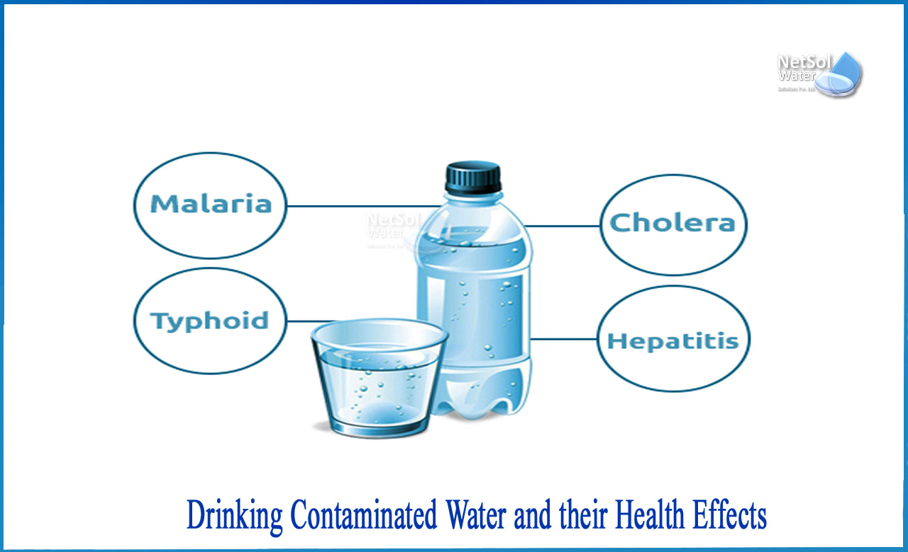
They are
WHAT ARE THE WATER RELATED PROBLEMS
DSCET

Slide 6
EXITING SYSTEM:
DSCET
The deteriorating quality of natural water resources like lakes, streams is one of the direst and most worrisome issues faced by humanity. The effects of un-clean water are far-reaching, impacting every aspect of life. Therefore, management of water resources is very crucial in order to optimize the quality of water.
if we will predict the water before drinking then we can save our lives from the damage of contaminated water
This issue has been addressed in many researches, but more work need to done in tearm of effectiveness of water, accuracy as well as usability of water
The goal of this study is to develop a water quality prediction model with the help of water quality factors using Convolutional Neural Network (ANN) and time-series analysis.

Slide 7
LITERATURE REVIEW
DSCET
S:NO | AUTHOR | TITLE | YEAR | DISCRIPTION | ADVANTAGES | DISADVANTAGES
1 | M. Awais, B. Aslam | Assessing nitrate contamination risks in groundwater: A machine learning approach | Oct. 2021 | Examining the results of the models showed that all of them had some over-estimation properties. By evaluating the results of the models based on the DDR index, it was found that the lowest DDR value was related to the performance of the SVM model. | to improve the accuracy of water quality prediction | Pre-processing techniques not satisfied
2 | S. Khalid, M. Shahid | A review of environmental contamination and health risk assessment of wastewater use for crop irrigation with a focus on low and high-income countries | May 2018 | In this review, we describe the cases in which machine learning algorithms have been applied to evaluate the water quality in different water environments, such as surface water, groundwater, drinking water, sewage, and seawater. Furthermore, we propose possible future applications of machine learning approaches to water environments. | Techniques are very strong | Low accuracy

Slide 8
LITERATURE REVIEW
DSCET
SNO | AUTHOUR | TITLE | YEAR | DISCRIPTION | ADVANTAGES | DISADVANTAGES
3 | K. F. Fung, Y. F. Huang | Improved SVR machine learning models for agricultural drought prediction at downstream of langat river basin, Malaysia | Dec. 2020 | water quality prediction using machine learning techniques. In this technique, our model predicts that the water is safe to drink or not using some parameters like Ph value, conductivity, hardness | It’s providing above 70% accuracy | Not a web based application
4 | D. T. Bui, K.Khosravi, | Improving prediction of water quality indices using novel hybrid machine-learning algorithms | Jun. 2020 | To estimate the water quality class, the paper used two types of classification algorithms: Decision Tree (DT) and K- Nearest Neighbor (KNN). Experiments were carried out utilizing a real dataset containing information from various locations around Andhra Pradesh, as well as a synthetic dataset generated at random using parameters | Web based application | Low accuracy

Slide 9
PROPOSED SYSTEM
DSCET
We are using real dataset from the water treatment station for analysis of the of the famous classification namely,
Decision Tree
Random Forest
Bagged Tree Models
Support Vector Machine
The experimentation results gave us a good proof of the performances of the classification techniques.
In addition it’s found that best algorithm seems adequate for our water quality monitoring system.
For further study, we are trying to integrate a new data aggregation algorithm to minimize the amount of the collected data to run the best classification algorith

Slide 10
ADVANTAGES OF PROPOSED SYSTEM:
DSCET
It reduces overfitting problem
It can also handle big data with numerous variables running into thousands.
learn events and make decisions by commenting on similar events

Slide 11
BLOCK DIAGRAM
DSCET
Data Preprocessing
Model Creation
Save
(Model, Weights)
Dataset
Model Training
Output
(Water quality)
With FLASK
Input
HTML

Slide 12
FLOW DIAGRAM
DSCET
Collect water dataset
Extract significant variables
Data pre-processing
Splitting
Training data
Testing data
Quality water
Algorithm
Classifier
Not a quality water

Slide 13
MODULES
DSCET
Data collection
Data pre-processing
Choose a model
Train the model
Evaluate the model
Parameter tuning
Make prediction

Slide 14
DATASET COLLECTION
DSCET
The quantity & quality of your data dictate how accurate our model is
The outcome of this step is generally a representation of data (Guo simplifies to specifying a table) which we will use for training
Using pre-collected data, by way of datasets from Kaggle, UCI, etc., still fits into this step

Slide 15
DATA PREPROCESSING
DSCET
Wrangle data and prepare it for training
Clean that which may require it (remove duplicates, correct errors, deal with missing values, normalization, data type conversions, etc.)
Randomize data, which erases the effects of the particular order in which we collected and/or otherwise prepared our data
Visualize data to help detect relevant relationships between variables or class imbalances (bias alert!), or perform other exploratory analysis
Split into training and evaluation sets

Slide 16
CHOOSE A MODEL
DSCET
Different algorithms are for different tasks; here we choose the Extra Trees Classifier

Slide 17
TRAIN THE MODEL
DSCET
The goal of training is to answer a question or make a prediction correctly as often as possible
Linear regression example: algorithm would need to learn values for m (or W) and b (x is input, y is output)
Each iteration of process is a training step

Slide 18
EVALUATATION OF MODEL
DSCET
Uses some metric or combination of metrics to "measure" objective performance of model
Test the model against previously unseen data.
This unseen data is meant to be somewhat representative of model performance in the real world, but still helps tune the model (as opposed to test data, which does not)
Good train/eval split? 80/20, 70/30, or similar, depending on domain, data availability, dataset particulars, etc.

Slide 19
PARAMETER TUNING
DSCET
This step refers to hyperparameter tuning, which is an "artform" as opposed to a science
Tune model parameters for improved performance
Simple model hyperparameters may include: number of training steps, learning rate, initialization values and distribution, etc.

Slide 20
PREDICTION
DSCET
Using further (test set) data which have, until this point, been withheld from the model (and for which class labels are known), are used to test the model; a better approximation of how the model will perform in the real world

Slide 21
ALGORITHM USED:
DSCET
Extra Trees Classifier
Extremely Randomized Trees Classifier(Extra Trees Classifier) is a type of ensemble learning technique which aggregates the results of multiple de-correlated decision trees collected in a “forest” to output it’s classification result. In concept, it is very similar to a Random Forest Classifier and only differs from it in the manner of construction of the decision trees in the forest. Each Decision Tree in the Extra Trees Forest is constructed from the original training sample. Then, at each test node, Each tree is provided with a random sample of k features from the feature-set from which each decision tree must select the best feature to split the data based on some mathematical criteria (typically the Gini Index). This random sample of features leads to the creation of multiple de-correlated decision trees. To perform feature selection using the above forest structure, during the construction of the forest, for each feature, the normalized total reduction in the mathematical criteria used in the decision of feature of split (Gini Index if the Gini Index is used in the construction of the forest) is computed. This value is called the Gini Importance of the feature. To perform feature selection, each feature is ordered in descending order according to the Gini Importance of each feature and the user selects the top k features according to his/her choice.

Slide 22
HARDWARE REQUIREMENTS
DSCET
System : Pentium i3 Processor.
Hard Disk : 500 GB.
Input Devices : Keyboard, Mouse
Ram : 2 GB

Slide 23
SOFTWARE REQUIREMENTS
DSCET
Operating system : Windows 10.
Coding Language : Python

Slide 24
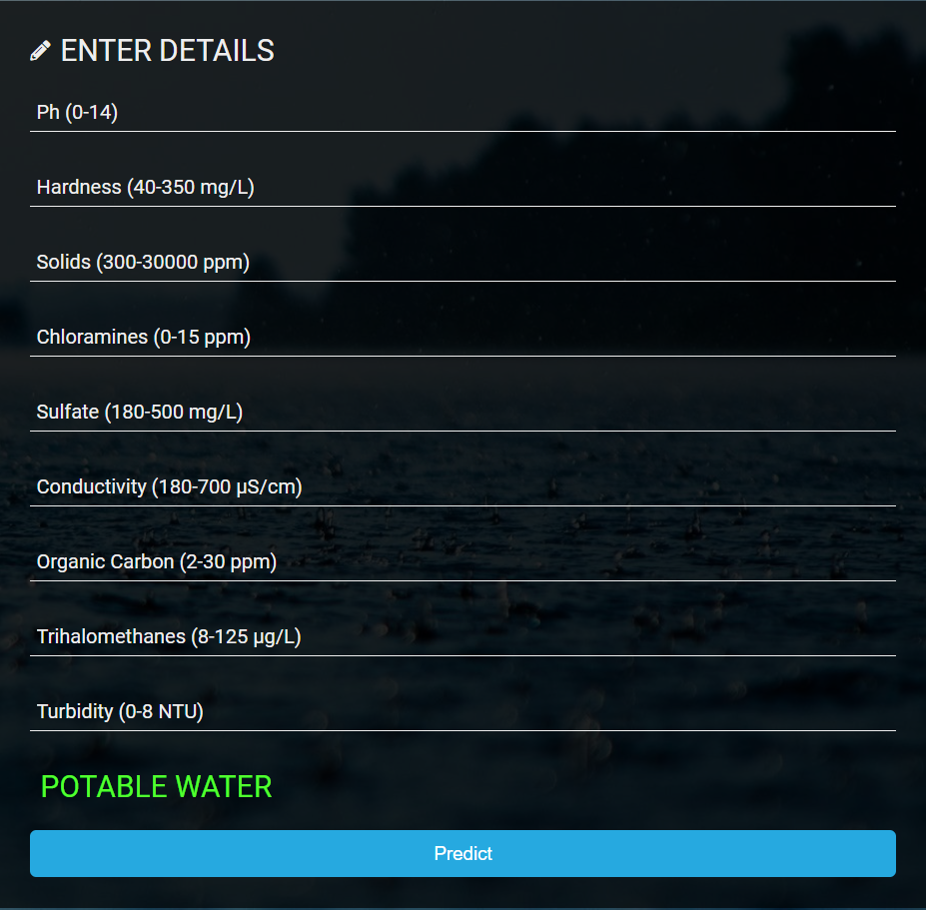
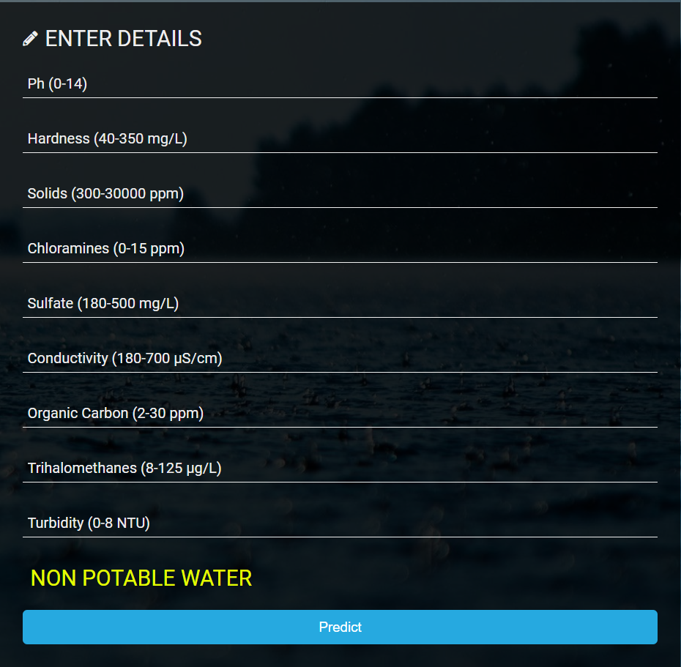
SAMPLE OUTPUT
DSCET
TEST CASE - 1
TEST CASE - 2

Slide 25
CONCLUSION
DSCET
Good Quality of Water Impact Good Health. Good quality water means that it is not only safe for public consumption but also good for our health, as well as that of animals and plants, as it provides irreplaceable nutrients and benefits needed to survive.

Slide 26
REFERENCES
DSCET
P. Zeilhofer, “GIS applications for mapping and spatial modeling of urban-use water quality: a case study in District of Cuiabá, Mato Grosso, Brazil,” Cad. Saúde …, vol. 23, no. 4, pp. 875–884, 2007.
UN water, “Clean water for a healthy world,” Development, pp. 1–16, 2010. K. Farrell-Poe, “Water Quality & Monitoring,” pp. 1–18, 2000.
T. Taskaya-Temizel and M. C. Casey, “A comparative study of autoregressive neural network hybrids,” Neural Networks, vol. 18, no. 5–6, pp. 781–789, 2005.
C. N. Babu and B. E. Reddy, “A moving-average filter based hybrid ARIMA–ANN model for forecasting time series data,” Appl. Soft Comput., vol. 23, no. January 2016, pp. 27–38, 2014

Slide 27
THANK YOU
DSCET

